Slide 1

CS5403 – Machine Learning
PBL Project Review–II
RiskRadar: Machine Learning Based Women Safety Zone Detection System
Presentation by
N.Venkatesan - 2104251040604
Neethivendhan.T - 2104251040629
CSE -A
Mentor
Dr.Vignesh.T
Professor
CSE

Slide 2
Project Progress Overview
Current Progress (%) – 25%
Completed Milestones - Problem Statement Finalized Dataset Generated (100,000 Records) Dataset Collection & Preparation Data Understanding Data Preprocessing Exploratory Data Analysis (EDA) Feature Engineering Train-Test Split Completed
Remaining Work - Train Machine Learning Models Compare Model Performance Model Optimization Save Best Model Prediction Testing Documentation & Final Presentation
Project Timeline – Completed dataset preparation, data analysis, model training in progress, model evaluation and final testing pending

Slide 3
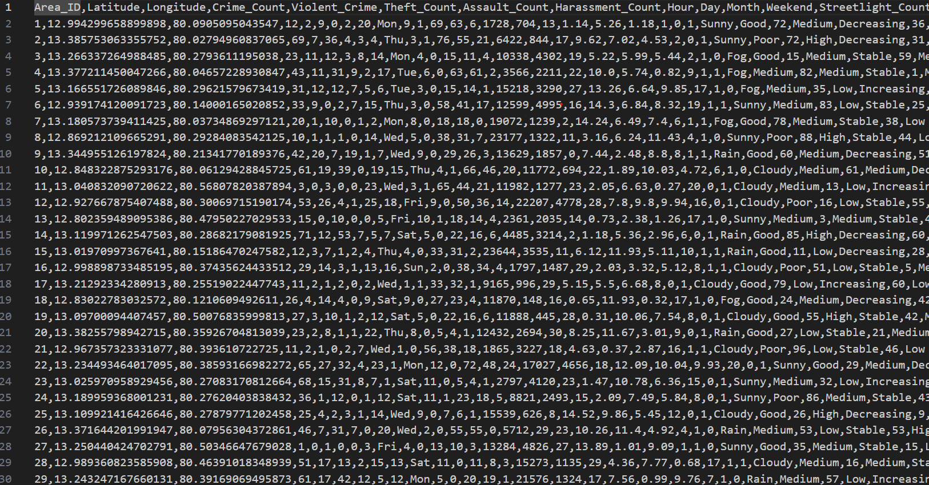
Data Collection & Analysis
Dataset Screenshot -
Dataset Description - The dataset was created to predict women's safety levels in different locations based on historical crime records, street lighting conditions, environmental factors, and population movement.
Total Number of samples - 100,000 Records

Slide 4
Methodology & Design
Workflow - Dataset Collection -> Data Preprocessing -> Exploratory Data Analysis -> Feature Engineering -> Train-Test Split -> Machine Learning Model -> Prediction -> Performance Evaluation
Algorithmic Flow – Currently implemented Decision Tree Classifier. Planned Random Forest, Logistic Regression, KNN
Technology Stac – Programming languages – Python, IDE – Jupyter Notebook, Libraries – Pandas, NumPy, Matplotlib, Seaborn, Scikit-Learn

Slide 5
System Architecture & Module Design
Modules:
Module 1: Dataset Collection
Module 2: Data Cleaning & Preprocessing
Module 3: Exploratory Data Analysis
Module 4: Feature Engineering
Module 5: ML Model Training
Module 6: Risk Level Prediction
Hardware:
AMD ryzen 7 processor
16 GB RAM
Windows 11
Software:
Python 3.13
Jupyter Notebook

Slide 6
Implementation Environment
Code Architecture (flow):
Import Libraries → Load Dataset → Analyze Dataset → EDA → Feature Engineering → Data Encoding → Train-Test Split → Train ML Model → Evaluate Model
IDE Used: Jupyter Notebook
Libraries:
Pandas, NumPy, Matplotlib, Seaborn, Scikit-Learn
GitHub Repository:
Will be uploaded after project completion

Slide 7
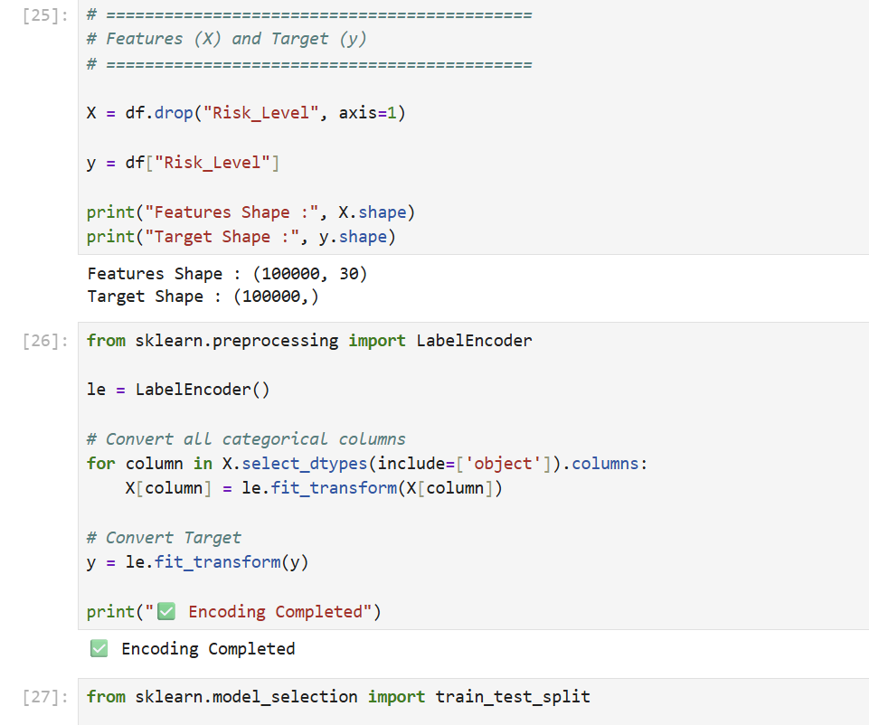
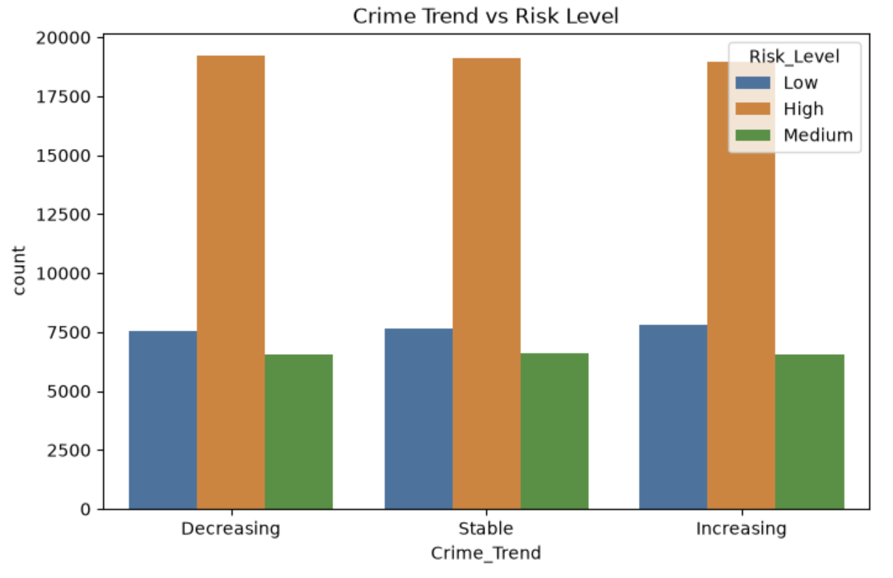
Implementation Progress
Completed:
Dataset Loaded Successfully
Dataset Analysis Done
Missing Value Analysis Done
Duplicate Check Done
Statistical Summary Generated
Correlation Heatmap Plotted
Risk Distribution Graph Plotted
Crime Distribution Graph Plotted
Weather Distribution Graph Plotted
Feature Engineering Done
Train-Test Split Done

Slide 8
Current Challenges & Future Direction
Challenges
Technical Challenges
Handling multiple categorical variables
Feature encoding
Dataset preprocessing
Dataset Challenges
Creating a realistic dataset
Balancing risk categories
Implementation Challenges
Selecting the most accurate ML model
Improving prediction accuracy
Next Plan
Complete Decision Tree Training
Train Random Forest Model
Compare Different Models
Evaluate Performance
Test New Predictions

Slide 9

N.Venkatesan and Neethivendhan.T

